Slide 1
Introduction to Language Resources and Corpora Session 02
Rhetoric Data Encounter Spring 2025

Slide 2
Content
Recap on Session 01: Introduction to Digital Humanities
Introduction to Language Resources, Technologies and Research Infrastructures
Introduction to Corpora
Working with Sketch Engine

Slide 3
Recap on Digital Humanities
Discussion:
What do you remember about last class?

Slide 4
Recap on Session 01: Introduction to Digital Humanities
Digital humanities:
Incorporating key insights from humanities fields with computer science, data science, information science, and other digital studies. The combination of these interdisciplinary fields lead to new frameworks and methodologies.
FAIR Principles:
Findable, Accessible, Interoperable, Reusable
Care Principles:
Collective benefit, Authority to Control, Responsibility, Ethics

Slide 5
Recap on Session 01: Introduction to Digital Humanities
Activity 1: Reflecting on Homework 02: Journal Article
In groups of 3 or 4 discuss and compare your answers to the following questions:
1. What academic discipline(s) is the research of your journal article rooted in?
2. Briefly describe the data collection and analysis process. (e.g. Does it adhere to the FAIR principles? What is it that makes this research “digital”?)
3. Describe the most important/interesting thing you learned from this article regarding digital humanities or the data collection/usage?
4. In your opinion, is there anything that the researchers could have improved upon regarding the data collection, usage, or distribution? Consider the FAIR principles

Slide 6
Recap on Digital Humanities
Activity 1: Reflecting on Homework 02: Journal Article
Class discussion:
How many different academic fields were we able to find?
Did the (majority of the) research articles adhere to the FAIR principles?
What were the different ways that made the research digital?
Did we find any research papers that made use of a corpus or another language resources as their data? What do you think these terms mean?

Slide 7
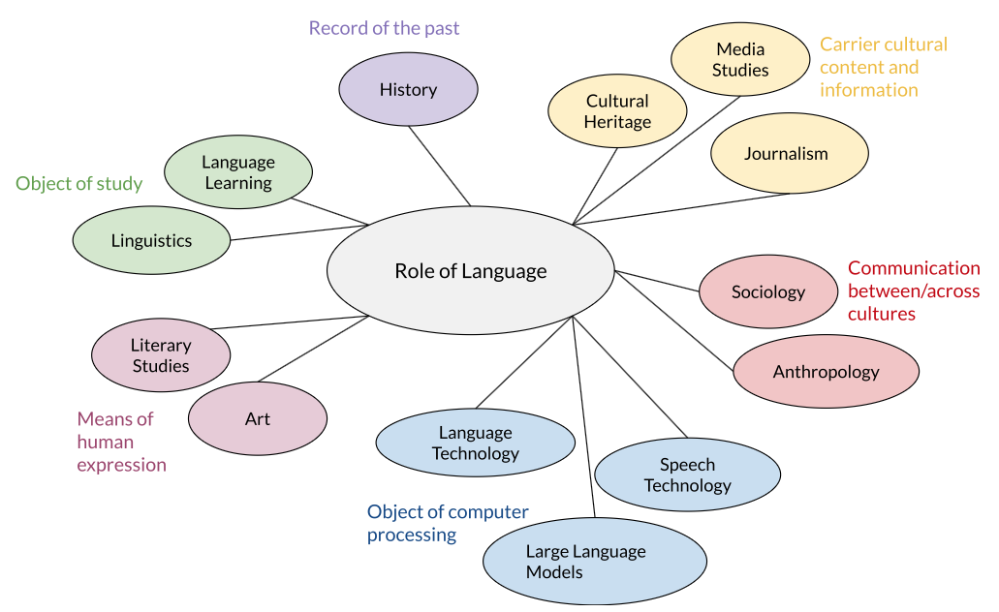
Introduction to Language Resources, Technologies and Research Infrastructures
Introductin to CLARIN (n.d.): Language plays a role in various academic disciplines
Discussion: Where do we place rhetoric?

Slide 8
Introduction to Language Resources, Technologies and Research Infrastructures
Introductin to CLARIN (n.d.):
Language resources: “A set of speech or language data and descriptions in machine readable form.”
Core usages:
Constructing and Evaluating ”Natural language and Speech algorithms” (for machine learning)
Language and Translation Studies
Electronic publishing, Software localisation, End-users and more.

Slide 9
Introduction to Language Resources, Technologies and Research Infrastructures
Introductin to CLARIN (n.d.):
Language Technologies: Computational methods designed for “analysing, producing, or modifying text and speech.”
Three main categories:
Text and Translation (f.e. Machine translation)
Interaction (f.e. Spoken interaction between humans and machines)
Analytics (f.e. Classification, Categorisation, Summarisation)

Slide 10
Introduction to Language Resources, Technologies and Research Infrastructures
Introductin to CLARIN (n.d.):
Typology of Language Resources:
Data: Corpora and Lexical/Conceptual Resources
Tools Services: Annotation and Search and Retrieval Applications
Metadata and Vocabularies
(European) Research Infrastructures (European, Commission, n.d.):
Provide open (language) resources, services, and technologies
Examples: Clarin, Clariah and other projects listed in the CORDIS database

Slide 11
Introduction to Corpora
Modern corpora are (Anderson & Corbett, 2017, pp.1-6):
“Vast electronic archives of written and spoken texts”
Easy to manipulate and analyse with software
Systemically designed for a specific purpose or purposes
Sample of “naturally occuring language”
Representative of a language (variety), register or genre
Purpose is to gain insights into (Anderson & Corbett, 2017):
How language is actually used opposed to how we think it is used
How commonly or typically it is used

Slide 12
Introduction to Corpora
Examples of Existing Corpora for a rhetorical analysis:
Corpus of US Supreme Court Opinions (English Corpora, n.d.)
Coronovirus Corpus (English Corpora, n.d.)
TED Corpus Search Engine (Hasebe, n.d.)
Scottisch Corpus of Texts & Speech (n.d.)
For Translation: Multilingual TEDx (Salesky et al., 2021) and OPUS (n.d.)
Parlamint (CLARIN, n.d.)

Slide 13
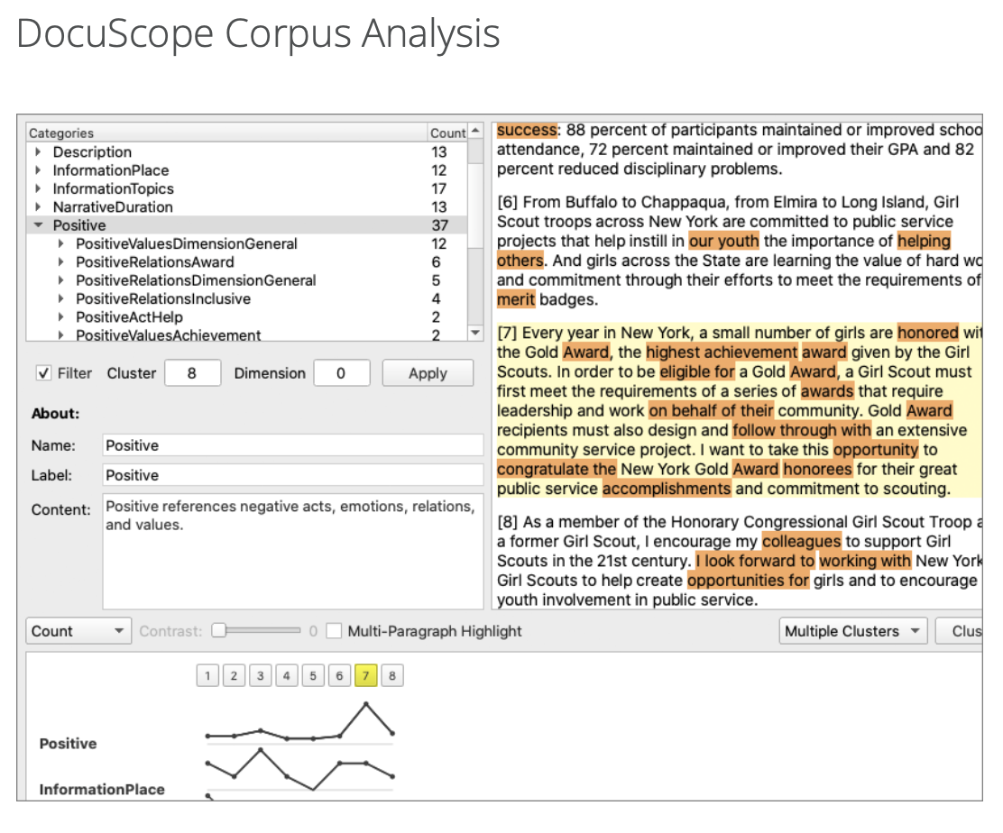
Introduction to Corpora
Examples of Existing Tools or Applications for Corpus-based (Rhetoric) Analysis:
English Corpora.org
AntConc
DocuScope
Sketch Engine
Carnegie Mellon University. (n.d.).

Slide 14
Working with Sketch Engine
Now it is time for us to construct and investigate our own corpus using Sketch Engine to answer the following research question:
Which rhetorical strategies, patterns, and fallacies, does Donald Trump apply in his insult tweets to attack and negatively portray his political opponents and critics?
Go to Moodle, and download the following files:
Datasets:
trump_insult_tweets_unique_2014_to_2021.csv
hillary_tweets.csv
Handout: AH_RHET101_DataEncounter_Activity02

Slide 15
Working with Sketch Engine
Sketch Engine offers access to various tools, of which we will be using the following:
Wordlist (Word frequency)
Concordance and KWIC (Key word in Context)
Word Sketch and Word Sketch Difference
N-grams
Keywords (comparing with other corpora)

Slide 16
Working with Sketch Engine: Wordlist
Complete Exercise 1
Discussion:
Which results did you note down to be particularly surprising or interesting? Why? Do you have a hypothesis on how these words are used in this context?

Slide 17
Working with Sketch Engine: Concordances
Complete Exercise 2:
Discussion:
Did you find any instances in which Trump modifies the names “Democrat Party” or “Republican Party” further to reflect his political opinions? Why do you think he applies this rhetoric?

Slide 18


Working with Sketch Engine: Concordances
Do you recognise any rhetorical strategies? What is their effect?

Slide 19
Working with Sketch Engine: Word Sketch difference
From Exercise 2, we get the feeling that Donald Trump modifies nouns related to the opposing (Democrat) party so that they have a more negative portrayal. Using Word Sketch, N-grams and Word Sketch Difference we will be looking into this further.
Complete Exercise 3:
Discussion: Looking at the modifiers and verbs Trump uses when writing about Hillary Clinton, Joe Biden and Bernie Sanders. Do these portray Clinton in a positive, neutral or negative light?

Slide 20

Working with Sketch Engine: Word Sketch difference
When taking more time to investigate other politicians, or other important US figures, we can find similar examples. What is the strategy that Trump seems to be applying here? Is it a fallacy?

Slide 21
Working with Sketch Engine: Word Sketch difference
Another way to retrieve arguments, or nicknames, that Trump uses repeatedly, is by looking for n-grams, which are 2 of more words that reoccur together frequently.
Discussion: Why is it more useful to search for larger n-grams (4-5) then smaller n-grams (2-3)? What results did you find?
Complete Exercise 4

Slide 22

Working with Sketch Engine: Word Sketch difference
When investigating the concordances for some of these n-grams, we can see how Trump depicts American journalism. What rhetorical strategies and/or fallacies are applied here?

Slide 23
Working with Sketch Engine: Word Sketch difference
Using Word Sketch Difference, we can investigate the differences in the usages of two different words.
Complete Exercise 5
Discussion: Compare the top verbs and adjective predicators of @FoxNews and @CNN as well as some of their concordances.
How does Trump’s word choices impact the ethos of these two news channels?
Why is it important to still investigate concordances?

Slide 24
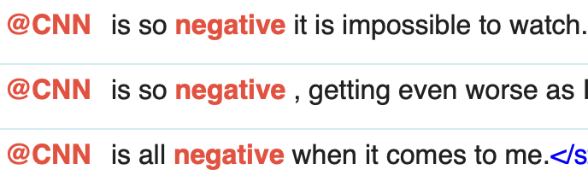
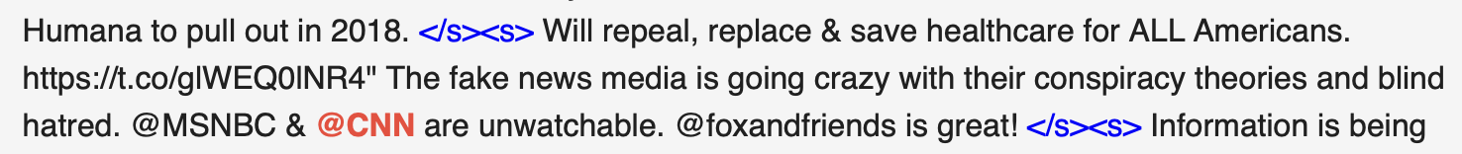


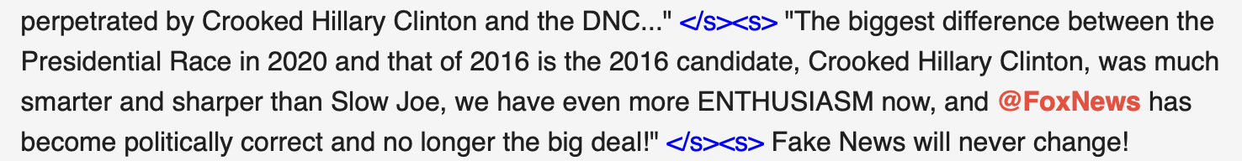
Working with Sketch Engine: Word Sketch difference
However, when investigating the keywords in context, it shows that our hypothesis are not always true. Did you find any other examples where Trump places @FoxNews in a more negative light?

Slide 25
Working with Sketch Engine: Keywords
Sometimes it can be worthwhile to compare a corpus (the target or focus corpus) to another corpus (a reference corpus) to identify what is unique or common.
Complete Exercise 6
Discussion: Comparing the keywords and concordances from the Trump Insult Tweets corpus and of the Hillary Tweets Corpus. Do they share a similar stance on migration? What do they say about each other’s stance on migration?

Slide 26
Working with Sketch Engine: Keywords
Donald Trump Hillary Clinton

Slide 27
Working with Sketch Engine: Conclusion
How can we answer our research question:
Which rhetorical strategies, patterns, and fallacies, does Donald Trump apply in his insult tweets to attack and negatively portray his political opponents and critics?

Slide 28
Working with Sketch Engine: Conclusion
Adding negative modifiers and verbs to his political opponents or critics which may decrease their ethos or serve as an appeal to pathos. (Ad hominem attack?)
Crooked Hillary, Sleepy Joe, Democratic Party of Hate | lie, fabricate, betray, impeach
Making use of nicknames to describe journalism and news channels that have written negatively about Donald Trump
Failing New York Times, The Fake News Media, the Enemy of the People
When comparing with tweets of Hillary Clinton, the different viewpoints of migration can be clearly distinguished

Slide 29
Next class
Introduction to R
To do: Complete Homework 03
Complete Sketch Engine task
Setting up R
Write in Logbook

Slide 30
References
Anderson, W., & Corbett, J. (2017). Exploring English with online corpora (2nd ed.). Palgrave
Macmillan.
Carnegie Mellon University. (n.d.). DocuScope. Retrieved 3 March 2025, from
https://www.cmu.edu/dietrich/english/research-and-publications/docuscope.html
CLARIN. (n.d.). Tutorial: Intro to CLARIN. Retrieved 14 February 2025, from
https://www.clarin.eu/content/tutorial-intro-clarin#unit-3-sharing-and-archiving-language-resources
English Corpora. (n.d.). Overview. Retrieved 3 March 2025, from https://www.english-
corpora.org/

Slide 31
References
European Commission. (2020, June 24). European Research Infrastructures. https://research-
and-innovation.ec.europa.eu/strategy/strategy-research-and-innovation/our-digital-future/european-research-infrastructures_en
Garg, A. (2021). All Trump’s Twitter insults (2014-2021) (Version 1) [Dataset]. Kaggle.
https://www.kaggle.com/datasets/ayushggarg/all-trumps-twitter-insults-20152021/data
Hamner, B. (2016). Hillary Clinton and Donald Trump Tweets (Version 1) [Dataset].
https://www.kaggle.com/datasets/benhamner/clinton-trump-tweets/data
Hasebe, Y. (n.d.). TCSE: TED Corpus Search Engine. Retrieved 3 March 2025, from
https://yohasebe.com/tcse
OPUS - Corpora. (n.d.). Retrieved 3 March 2025, from https://opus.nlpl.eu/

Slide 32
References
Salesky, E., Wiesner, M., Bremerman, J., Cattoni, R., Negri, M., Turchi, M., Oard, D. W., & Post,
M. (2021). The Multilingual TEDx Corpus for Speech Recognition and Translation (Version 2). arXiv. https://doi.org/10.48550/ARXIV.2102.01757
Scottish Corpus of Texts & Speech (n.d.). Retrieved 3 March 2025, from
https://www.scottishcorpus.ac.uk/

